Slide 1
Deep Learning-Based Sports Activity Recognition System for Video Analysis
Guidance by :- PROF. Aparna Gurjar
Project By-
Manan Jain(33)
Rishi Sharma (53)

Slide 2
Problem Statement
Design and implement a deep learning model capable of predicting the sport being played based on video input. The model should be trained on a diverse dataset of sports images, encompassing various sports such as football, basketball, tennis, and others. It should be able to analyze visual cues, motion patterns, and contextual information to infer the specific sport being played in real-time video streams or recorded footage. The objective is to develop a robust and efficient system that can automatically identify the sport being played, catering to applications in video content categorization, sports broadcasting, and real-time event detection.

Slide 3
RESNET50
ResNet50 is a convolutional neural network (CNN) architecture with 50 layers. Which are 48 convolutional layers, one MaxPool layer, and one average pool layer. It incorporates skip connections, known as residual connections, to mitigate the vanishing gradient problem in deep networks. It consists of convolutional layers, residual blocks, identity blocks, and global average pooling, followed by fully connected layers for classification. ResNet50 is widely used in image classification, object detection, and image segmentation tasks due to its depth and superior performance.

Slide 4
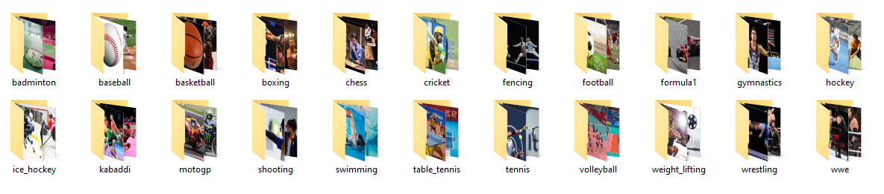
Dataset
1000 Images (.JPEG) of Each Sport
https://drive.google.com/drive/u/0/folders/1GQn4STiIvgky94x3qbhOh446vY_rLn2g
Dataset

Slide 5
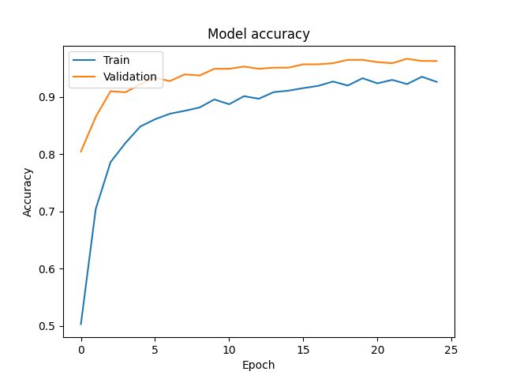
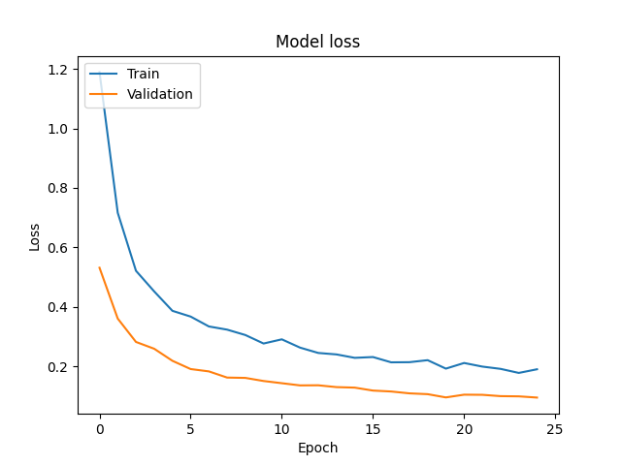
Model Accuracy & Loss

Slide 6
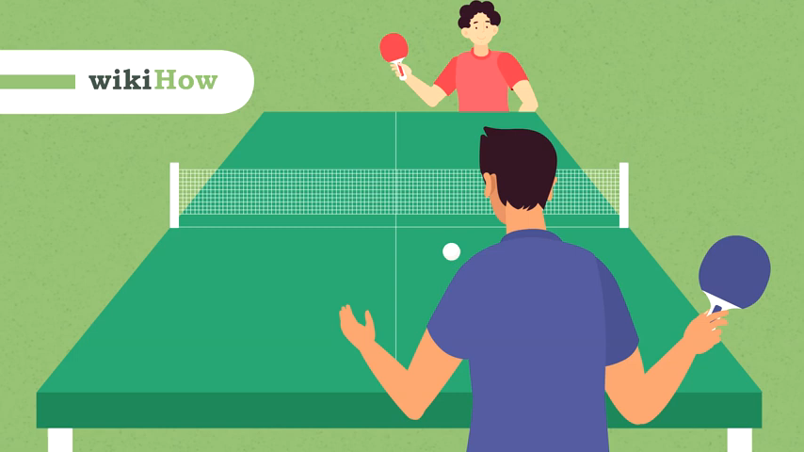
input
Real-time Input Video

Slide 7
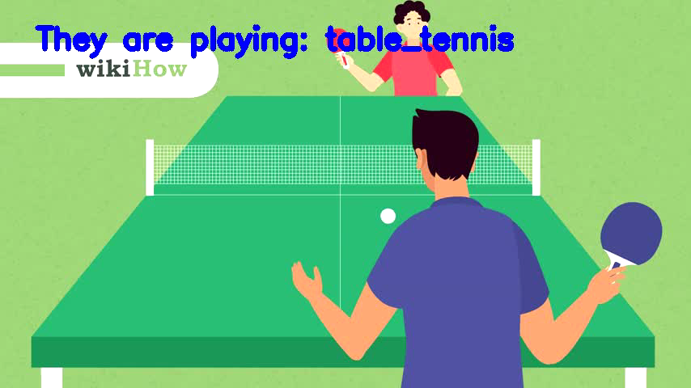
Output
Real-time Output Video

Slide 8
Thank You

